Slide 1

Hands-On Ethical Hacking and Network Defense,
Edition 4
Module 5: Port Scanning
Simpson, Antill, Wilson, Hands-On Ethical Hacking and Network Defense, 4th Edition. © 2023 Cengage. All Rights Reserved. May not be scanned, copied or duplicated, or posted to a publicly accessible website, in whole or in part.

Slide 2
Module Objectives
By the end of this module, you should be able to:
  Describe port scanning and types of port scans
  Describe port-scanning tools
  Explain what ping sweeps are used for
  Explain how shell scripting is used to automate security tasks

Slide 3
Introduction to Port Scanning (1 of 3)
Port scanning
  Method of finding which services are offered by a host computer
  Identifies vulnerabilities
Port-scanning tools
  Identify vulnerable open ports and launch an exploit to attack the system
Security testers must scan all ports when testing
  Not just well-known ports

Slide 4
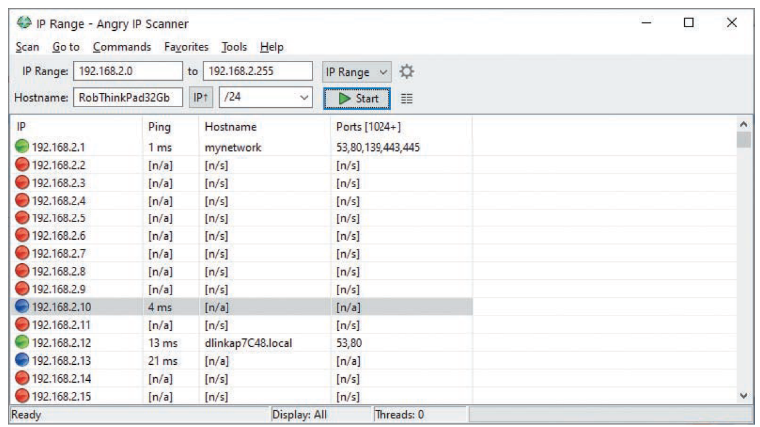
Introduction to Port Scanning (2 of 3)
Source: Angry IP Scanner
Figure 5-1 Angry IP port scanner interface

Slide 5
Introduction to Port Scanning (3 of 3)
Port-scanning programs report:
  Open ports
    Allow access to applications and can be vulnerable to an attack
  Closed ports
    Don’t allow entry or access to a service
  Filtered ports
    Might indicate that a firewall is being used to allow specified traffic into or out of the network

Slide 6
Types of Port Scans (1 of 2)
SYN scan
  Stealthy scan
Connect scan
  Completes the three-way handshake
NULL scan
  All packet flags are turned off
XMAS scan
  FIN, PSH, and URG flags are set

Slide 7
Types of Port Scans (2 of 2)
ACK scan
  Used to get past a firewall or other filtering device
FIN scan
  Closed port responds with an RST packet when the FIN packet is sent to the target computer
UDP scan
  UDP packet is sent to the target computer
    If port sends back an ICMP “Port Unreachable” message
      Implies that the port is closed

Slide 8
Knowledge Check Activity 5-1
Security testers and hackers use which of the following to determine the services running on a host and the vulnerabilities associated with these services?
Zone transfers
Zone scanning
Encryption algorithms
Port scanning
Notes:
Instructions:
Use the Knowledge Check questions to periodically pose a question to students during class to gauge how well they can recall the material that was presented.

Slide 9
Knowledge Check Activity 5-1: Answer
Security testers and hackers use which of the following to determine the services running on a host and the vulnerabilities associated with these services?
Answer: d. Port scanning
Port scanning is a method of finding out which services a host computer offers. Port-scanning tools can be used to identify vulnerabilities associated with these services.

Slide 10
Polling Activity 5-1
A FIN packet sent to a closed port responds with which of the following packets?
FIN
SYN-ACK
RST
SYN
Notes:
Instructions:
1. Use this activity to solicit student opinions about concepts in the module or to play a game.
2. Go to kahoot.com, or the platform of your preference, and log in or sign up.
3. Create the challenge.
4. Teacher Tip: Turn off the timer to prioritize accuracy or turn on the nickname generator to avoid inappropriate nicknames.
5. Invite players by sharing the link or PIN.
6. This can be done synchronously during class or asynchronously for review or homework.

Slide 11
Polling Activity 5-1: Answer
A FIN packet sent to a closed port responds with which of the following packets?
Answer: c. RST
When a port is closed in a FIN scan, it sends back an RST packet.

Slide 12
Discussion Activity 5-1
A NULL scan requires setting the FIN, ACK, and URG flags. True or false?
Discuss the answer with your classmates.
Notes:
Instructions:
Use the Discussion activity to encourage group conversation about a related topic of interest.

Slide 13
Discussion Activity 5-1: Answer
A NULL scan requires setting the FIN, ACK, and URG flags. True or false?
Answer: False
Explanation: A NULL scan does not require setting the FIN, ACK, and URG flags. The FIN, PSH, and URG flags are set in an XMAS scan.

Slide 14
Using Port-Scanning Tools
Port-scanning tools
  Hundreds are available
  Not all are accurate
    Be familiar with a variety of tools
    Practice often to gain proficiency
  Do not use one tool exclusively
Some tools include:
  Nmap
  Nessus and OpenVAS

Slide 15
Nmap (1 of 2)
Originally written for Phrack magazine
  One of the most popular port-scanning tools
  New features are frequently added
GUI front end
  Known as Zenmap
  Makes working with complex options easier
Standard port-scanning tool for security professionals
  Command: nmap 193.145.85.201
    Scans every port on the computer with this IP address

Slide 16
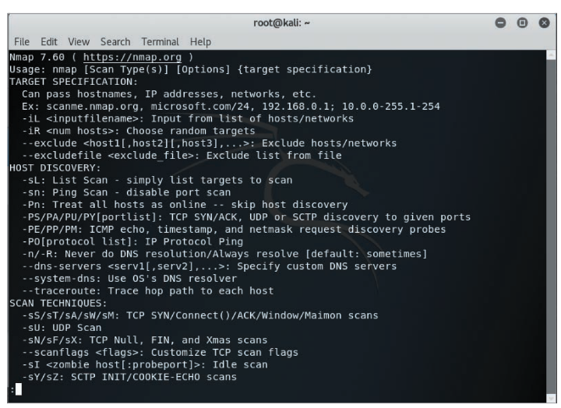
Nmap (2 of 2)
Source: Kali Linux
Figure 5-2 Nmap help screen

Slide 17
Nessus and OpenVAS (or Greenbone Security Assistant) (1 of 4)
Nessus
  Vulnerable assessment tool from Tenable
  Extends NMAP capabilities by analyzing open ports for specific version information
  Provides detailed vulnerability information on the corresponding service
  Nessus Professional
    Product you purchase
  Nessus Essentials
    Provides a free version

Slide 18
Nessus and OpenVAS (or Greenbone Security Assistant) (2 of 4)
OpenVAS
  Open-source fork of Nessus
  Now branded as Greenbone Security Assistant
  Capable of updating security check plug-ins when they become available
    Security test program that can be selected from the client interface
    Leaving the Safe checks enabled in the policy is advisable
    Can also determine what vulnerabilities are associated with services

Slide 19
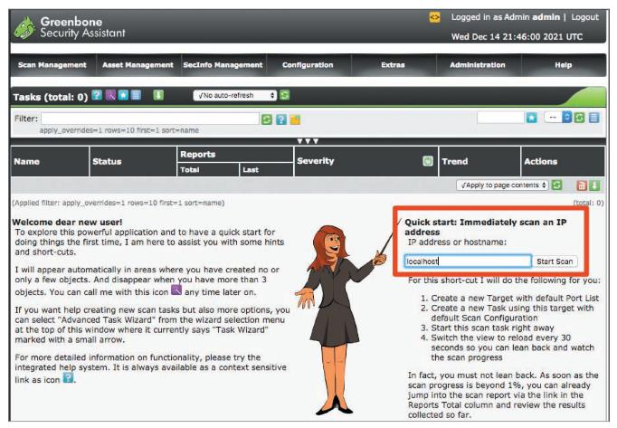
Nessus and OpenVAS (or Greenbone Security Assistant) (3 of 4)
Source: GNU General Public License
Figure 5-4 OpenVAS (Greenbone Security Assistant) home screen

Slide 20
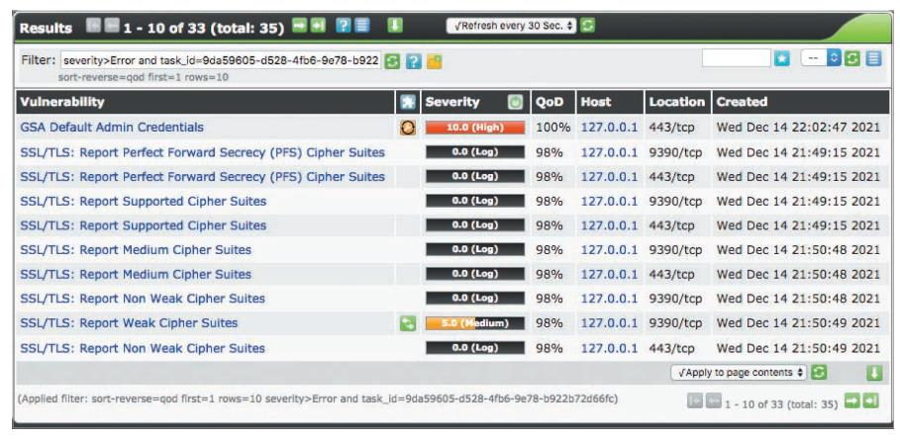
Nessus and OpenVAS (or Greenbone Security Assistant) (4 of 4)
Figure 5-5 Vulnerabilities listed in OpenVAS

Slide 21
Knowledge Check Activity 5-2
What is the most widely used port-scanning tool?
Netcat
Netstat
Nmap
Nslookup
Notes:
Instructions:
Use the Knowledge Check questions to periodically pose a question to students during class to gauge how well they can recall the material that was presented.

Slide 22
Knowledge Check Activity 5-2: Answer
What is the most widely used port-scanning tool?
Answer: c. Nmap
Nmap is currently the standard port-scanning tool for security professionals. Regardless of the other port-scanning tools available, any security tester with a modicum of experience has worked with Nmap. It is one of the most popular port scanners and adds new features constantly.

Slide 23
Polling Activity 5-2
Which of the following Nmap commands sends a SYN packet to a computer with the IP address 193.145.85.210? (Choose all that apply.)
nmap -sS 193.145.85.210
nmap -v 193.145.85.210
nmap -sA 193.145.85.210
nmap -sF 193.145.85.210
Notes:
Instructions:
1. Use this activity to solicit student opinions about concepts in the module or to play a game.
2. Go to kahoot.com, or the platform of your preference, and log in or sign up.
3. Create the challenge.
4. Teacher Tip: Turn off the timer to prioritize accuracy or turn on the nickname generator to avoid inappropriate nicknames.
5. Invite players by sharing the link or PIN.
6. This can be done synchronously during class or asynchronously for review or homework.

Slide 24
Polling Activity 5-2: Answer
Which of the following Nmap commands sends a SYN packet to a computer with the IP address 193.145.85.210?
Answer: a and b
nmap -sS 193.145.85.210
nmap -v 193.145.85.210
To send a SYN packet to a computer with the IP address 193.145.85.210, type nmap -sS 193.145.85.210 or nmap -v 193.145.85.210 and press Enter.

Slide 25
Conducting Ping Sweeps
Ping sweeps
  Identify which IP addresses belong to active hosts
    Ping a range of IP addresses to see what type of response is returned
Problems
  Might shut down computers at the time of the sweep
    Indicates that the IP address does not belong to a live host
  Many network administrators configure nodes to not respond to an ICMP Echo Request (type 8) with an ICMP Echo Reply (type 0)
  Firewalls may filter out ICMP traffic

Slide 26
Fping (1 of 4)
With the Fping tool, you can ping multiple IP addresses simultaneously
  Included with Kali Linux
Accepts a range of IP addresses
  Entered at a command prompt
  You can create a file containing multiple IP addresses
    Use it as input for the Fping command
Input file
  Usually created with a shell-scripting language so that you don’t need to type thousands of IP addresses needed for a ping sweep

Slide 27
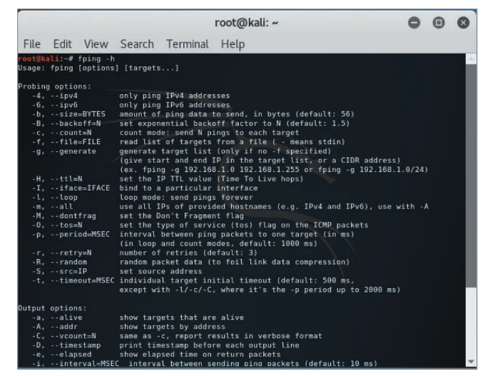
Fping (2 of 4)
Figure 5-6 Fping parameters
Source: GNU Public License

Slide 28
Fping (3 of 4)
To ping sweep a range of IP addresses without using an input file, use the command:
  fping –g BeginningIPaddress EndingIPaddress
  The –g parameter is used when no input file is available
  Example:
    fping –g 192.168.185.1 192.168.185.5 command returns the results shown on Figure 5-6

Slide 29
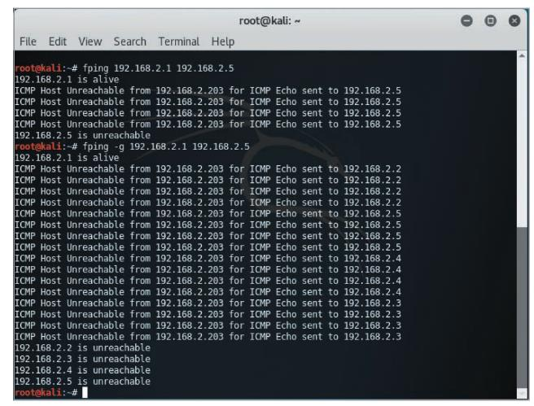
Fping (4 of 4)
Figure 5-7 Results of fping commands
Source: GNU General Public License

Slide 30
Hping3 (1 of 4)
Used to:
  Perform ping sweeps
  Bypass filtering devices
    Allows users to inject modified IP packets
Advanced port-scanning tool
  All security testers must be familiar with this tool
  Offers a variety of features

Slide 31
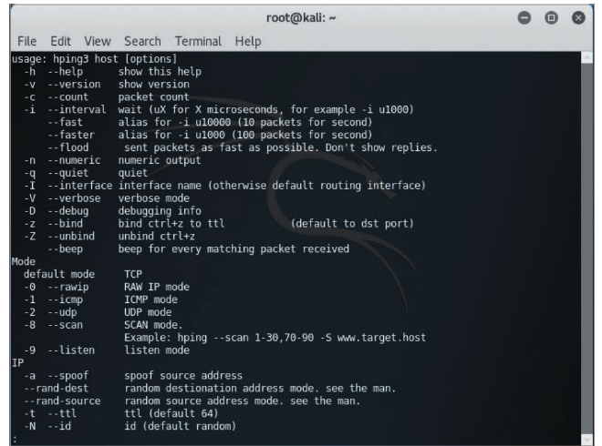
Hping3 (2 of 4)
Figure 5-8 Hping3 help page 1
Source: GNU General Public License

Slide 32
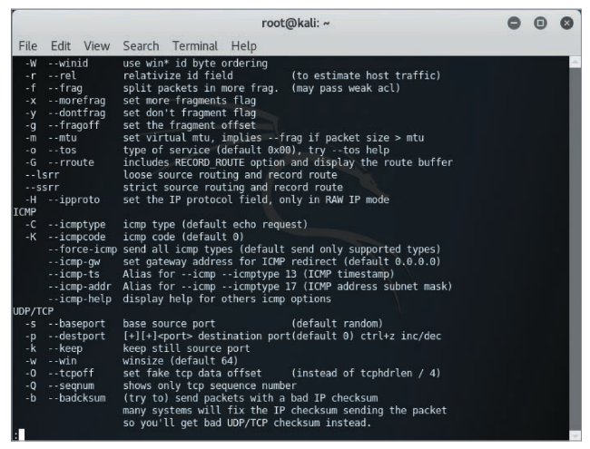
Hping3 (3 of 4)
Figure 5-9 Hping3 help page 2
Source: GNU General Public License

Slide 33
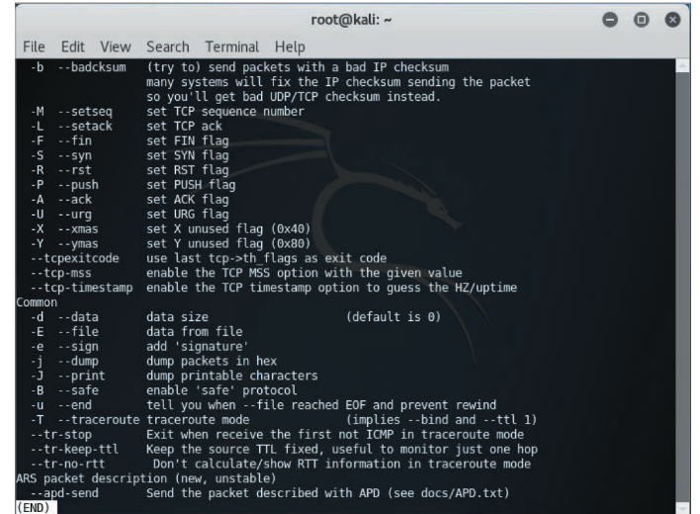
Hping3 (4 of 4)
Figure 5-10 Hping3 help page 3
Source: GNU General Public License

Slide 34
Crafting IP Packets
Packets contain:
  Source IP addresses
  Destination IP addresses
  Information about flags
Helpful tools for crafting IP packets
  Hping3
  Fping

Slide 35
Understanding Scripting
Some tools might need to be modified to better suit your needs as a security tester
Customized scripts
  Automates tasks
  Time-saving
  Requires basic programming skills

Slide 36
Scripting Basics (1 of 2)
Similar to DOS batch programming
A script or batch file
  Text file that contains multiple commands that are usually entered manually at the command prompt
If you find that you are using repetitive commands to perform the same task, that task is a good candidate for scripting
Best way to learn how to create a script
  Create a script by doing it

Slide 37
Summary of Vim Commands
vim command | Description
A | Appends text after the insertion point
I | Inserts text before the insertion point
Delete key | Overwrites the last character when in Insert mode
X | Deletes the current character
Dd | Deletes the current line
Dw | Deletes the current word
P | Replaces the previously deleted text
Wq | Writes changes and quits the edit session
ZZ | Exits vi and saves all changes

Slide 38
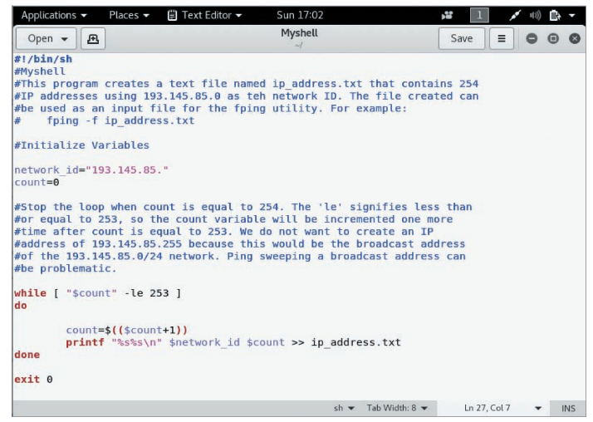
Scripting Basics (2 of 2)
Figure 5-11 Shell script with comments
Source: Kali Linux gedit

Slide 39
Self-Assessment
Recall some of the tools used to conduct a ping sweep of a network.
Recall the types of port scans that can be used for port scanning.
Notes:
Instructions:
Use the Self-Assessment question to encourage students to evaluate their progress or goals in the course, as well as determine how they might apply their learning or grow as an individual.

Slide 40
Summary
Now that the lesson has ended, you should be able to:
  Describe port scanning and types of port scans
  Describe port-scanning tools
  Explain what ping sweeps are used for
  Explain how shell scripting is used to automate security tasks

